Slide 1
Real World Application of Data Structures
Naman Goyal, Vishal Singh, Aditya Gupta

Slide 2
AVL Tree
Application in Memory Management of Linux

Slide 3

Memory Management
Virtual memory and Physical Memory
Loading an executable image
Page Fault

Slide 4
Handling Page Fault
Search the area in memory map to find which area is involved.
Searching through the structures is critical to the efficient handling of page faults, these are linked together in an AVL tree

Slide 5
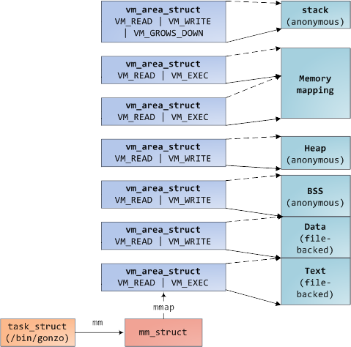
class mm_struct {
//AVL Tree based ordered map
class vm_area_struct* mmap_avl;
};

Slide 6
Graphs
Application in Page Rank

Slide 7
Page Rank
Used to rank websites in search engine results.
Counts the number and quality of links to a page
Use directed Graph

Slide 8
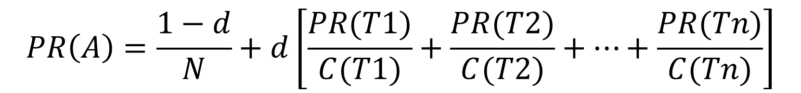
$$PR\left(A\right)=\frac{1−d}{N}+d\left[\frac{PR(T1)}{C(T1)}+\frac{PR(T2)}{C(T2)}+…+\frac{PR(Tn)}{C(Tn)}\right]$$

Slide 9
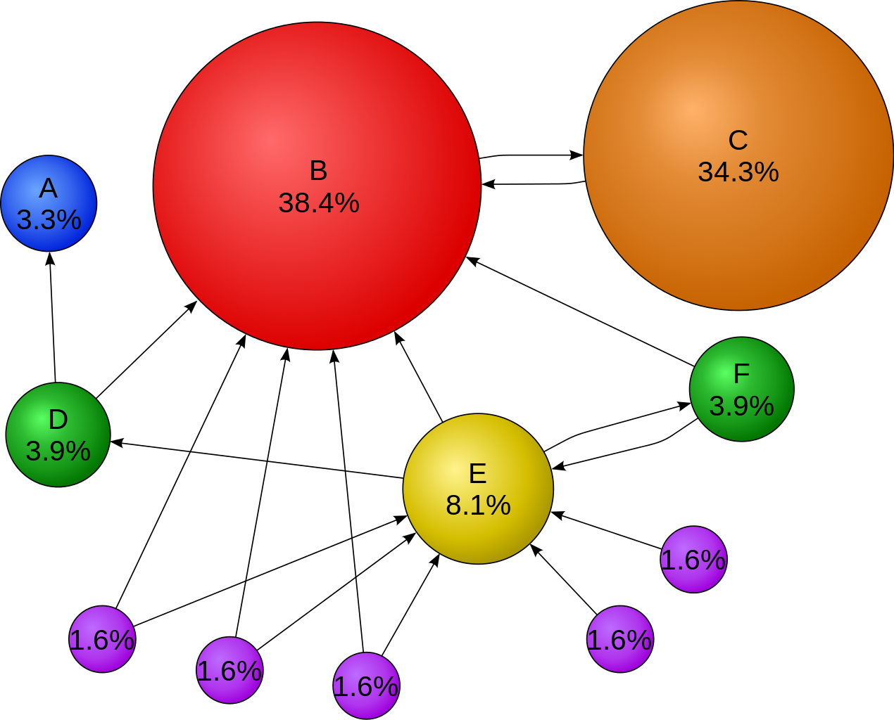
d = 85%

Slide 10
Hash Table
Applications in dictionary clients

Slide 11
Problem: Dictionary Lookup
Receive a Comma-Separated Value (CSV) file.
Sample Applications:
DNS Lookup
Amino Acids
Class list
TTT,Phe,F,Phenylalanine
TTC,Phe,F,Phenylalanine
TTA,Leu,L,Leucine
TTG,Leu,L,Leucine
TCT,Ser,S,Serine
TCC,Ser,S,Serine
TCA,Ser,S,Serine
…
amino.csv

Slide 12
Problem Details: Example Usage
TTT,Phe,F,Phenylalanine
TTC,Phe,F,Phenylalanine
TTA,Leu,L,Leucine
TTG,Leu,L,Leucine
TCT,Ser,S,Serine
TCC,Ser,S,Serine
TCA,Ser,S,Serine
TCG,Ser,S,Serine
TAT,Tyr,Y,Tyrosine
TAC,Tyr,Y,Tyrosine
TAA,Stop,Stop,Stop
TAG,Stop,Stop,Stop
TGT,Cys,C,Cysteine
TGC,Cys,C,Cysteine
TGA,Stop,Stop,Stop
TGG,Trp,W,Tryptophan
CTT,Leu,L,Leucine
CTC,Leu,L,Leucine
CTA,Leu,L,Leucine
CTG,Leu,L,Leucine
CCT,Pro,P,Proline
CCC,Pro,P,Proline
CCA,Pro,P,Proline
CCG,Pro,P,Proline
CAT,His,H,Histidine
CAC,His,H,Histidine
CAA,Gln,Q,Glutamine
CAG,Gln,Q,Glutamine
CGT,Arg,R,Arginine
CGC,Arg,R,Arginine
...
Codon is key
Name is value
> csv_lookup amino.csv 0 3
ACT
Threonine
TAG
Stop
CAT
Histidine

Slide 13
C++ Implementation
#include <cstdlib>
#include <fstream>
#include <iostream>
#include <map>
#include <string>
#include <sstream>
using namespace std;
int main(int argc, char **argv) {
ifstream in; in.open(argv[1]);
int key_field = atoi(argv[2]);
int val_field = atoi(argv[3]);
map<string, string> mp;
string line;
if (in.is_open()) {
while (getline(in, line, '\n')) {
stringstream ss(line);
string token, key_token, val_token;
int ind = 0;
while (getline(ss, token, ',')) {
if (ind == key_field) key_token = token;
else if (ind == val_field) val_token = token;
ind++;
}
mp[key_token] = val_token;
}
} else cout << "Couldn't open file " << argv[1] << ".\n";
string query;
while (cin >> query) {
if (mp.find(query) == mp.end()) cout << "Not Found.\n";
else cout << mp[query] << "\n";
}
}
I/O
Creating Symbol Table
Processing Queries

Slide 14
Red-Black Tree
Applications in Linux Kernel’s completely fair scheduler

Slide 15
Problem: OS Scheduling
Goal: fairness in dividing processor time to tasks.
Task scheduling is an important aspect to operating system design.
Example Schedulers:
First Come, First Serve
Shortest Job First
Priority
Round Robin

Slide 16
Completely Fair Scheduler
Queue ordered in terms of “virtual run time”
smallest value picked for using CPU
small values: tasks have received less time on CPU
tasks blocked on I/O have smaller values
execution time on CPU added to value
priorities cause different decays of values
Bottom Line: The smaller a task's virtual runtime, the higher its need for the processor

Slide 17
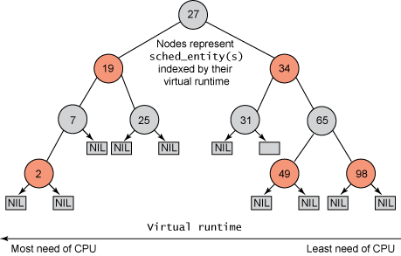
Example of CFS Tree
The key for each node is the virtual runtime of the corresponding task.
To pick the next task to run, simply take the leftmost node.

Slide 18
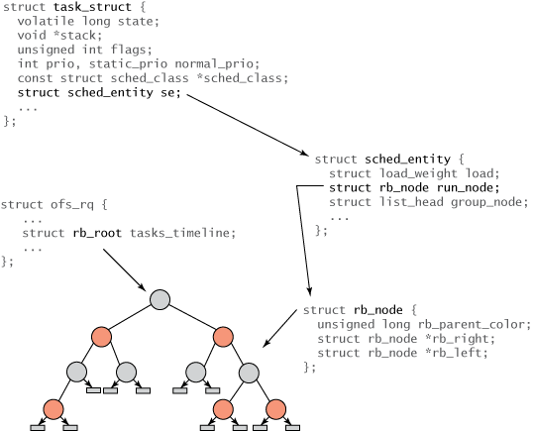
C++ Implementation
task_struct : All tasks within Linux.
sched_entity : Entity created to track scheduling information
rb_root : root of the tree
Internal nodes represent one or more tasks that are runnable.
The rb_node is contained within the sched_entity structure, which includes the rb_node reference, load weight, and a variety of statistics data
sched_entity contains the vruntime

Slide 19
Tries
Applications in IP Lookup

Slide 20
IP Lookup
IP lookup is the most frequently used job. Searching IP from huge number of IPs can be done using prefix tries easily in O(32) for IPv4 and O(128) for IPv6
Route Lookup: Each IP address lookup starts at the root node of the trie. Based on the destination address of the packet, the search procedure determines whether the left or the right node is to be visited. The prefix node found along the path that contains forwarding information is maintained as Best Matching Prefix (BMP) while the trie is traversed.

Slide 21
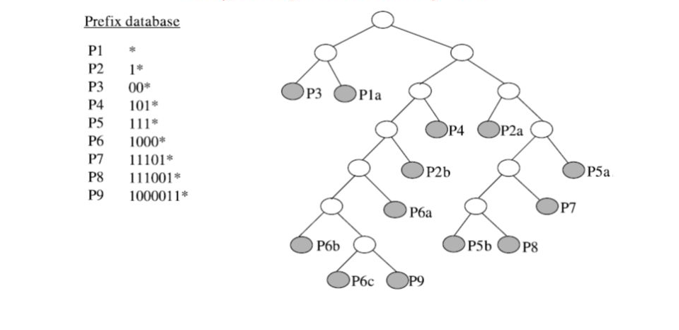

Slide 22
Queue
Applications in Round-Robin OS Scheduling

Slide 23
Round Robin OS Scheduling
Round-Robin (RR) is one of the algorithms employed by process and network schedulers in computing.
It equally divides quanta of time among various process.
Job 1 = Total time to complete 250 ms (quantum 100 ms).
First allocation = 100 ms.
Second allocation = 100 ms.
Third allocation = 100 ms but job1 self-terminates after 50 ms.
Total CPU time of job1 = 250 ms

Slide 24
Complexity Analysis
P0
P0 arrives and gets processed
P0 | P1
P1 arrives and wait for the quanta to expire
P1 | P0
Quanta expires , P1 getting processed
P1 | P0 | P2
P2 arrives
P0 | P2
P1 processed, jumps to P2 even quanta is left
P2
P0 processed
Complexity: Insert O(1), Fetch O(1)
Weighted round robin

Slide 25
Heap
Applications in LRU Cache replacement policy

Slide 26
LRU Replacement Policy
LRU (least recently used) cache is a good way of implementing cache because it frees up precious memory based on the last time an element was used. (This reduces the misses and increases the performance)
Whenever there is a cache miss (capacity miss) , we need to decide which block to replace from the cache such that the removed data doesn’t produce any further miss.

Slide 27
Complexity Analysis
The data which is least recently used is removed. For this a min heap is used which tells the minimum used in O(1).
Whenever we access the block we update a counter which tells us how recently the element has been used.
Update : O (log(n))
We read/write in a cache. Whenever there is a miss we bring the data from lower cache
Delete in Cache : O(log(n))
Insert in Cache: O(log(n))

